Slide 1
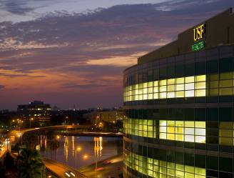
Scholarly Concentrations Program – How to Successfully Foster Medical Student Scholarship
IAMSE 2014
Susan Pross, PhD Director
Ingrid Bahner, PhD Associate Director
Roberta “Bobby” Collins Program Administrator
Morsani College of Medicine
University of South Florida

Slide 2
Rationale for This Session Discuss Goals of SCP and Challenges
Cultivate a spirit of inquiry
Incorporate individuated curricula that foster scholarship
Scientific attitude in the practice of medicine
Possibly leads to improved patient outcome
Students may choose schools based on SCPs
Nationwide, SCPs are elective/required
Nationwide, SCPS 2 year/4 year programs
When elective, students typically enroll in high numbers
MCOM SCP:
Elective
85% enrollment
4 years of medical school

Slide 3
Objectives for Session
This workshop will familiarize participants with challenges, opportunities and successes of such a program.
Topics range from general considerations to practicalities of operation and long-term outcome assessments.
By the end of the session, participants will be able to:
Incorporate specific ideas and concepts into development of a sustainable SCP
Develop strategies of how to recruit and maintain faculty leaders and mentors
Utilize resources and tools to administer and evaluate an SCP

Slide 4
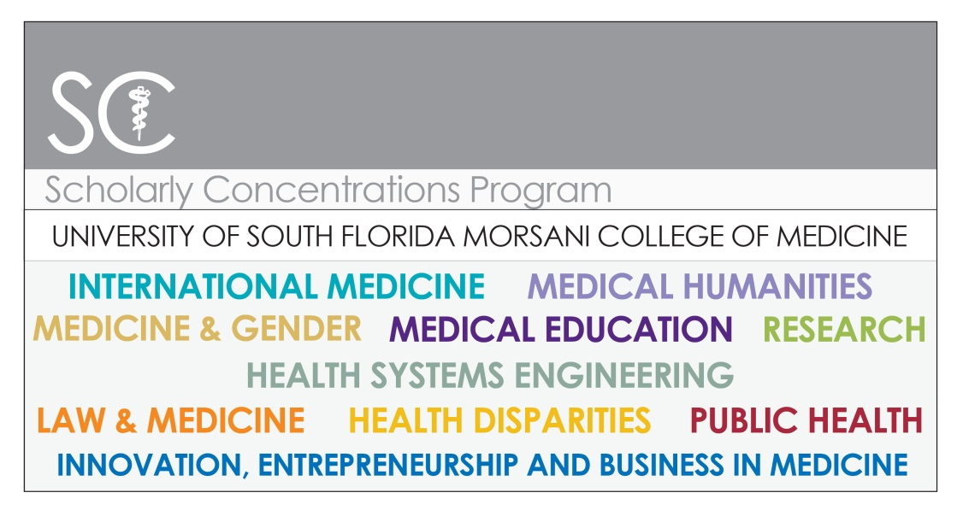
Scholarly Concentrations Program USF MCOM
Biomedical Research
Health Disparities
Health Systems Engineering
Innovation, Entrepreneurship & Business in Medicine
International Medicine
Law and Medicine
Medicine and Gender
Medical Education
Medical Humanities
Public Health

Slide 5
Program Description
Year 1
Enroll in SCP
General curriculum
IRB, Statistics, Endnote, Scholarly Writing
Individual curriculum
Select Project; Identify Mentor
Write Summer Project Proposals
Summer Year 1 and 2
Work on Scholarly Project
Take Statistics Class
Individual curriculum
Year 2
General curriculum
How to Make and Present a Poster/Talk
SCP Symposium in fall
Year 3
General curriculum
Two 2 week elective times
Individual curriculum
Year 4
General curriculum
Two 2 week elective times
Individual curriculum
Gallery of Scholarship

Slide 6
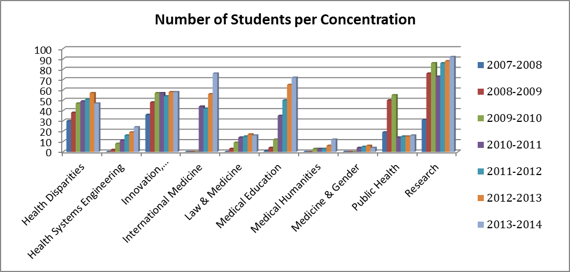
Enrollment in SCP 2007-2013

Slide 7
Time in the Curriculum for SCP Year 1

Slide 8
Time in the Curriculum for SCP Year 2

Slide 9
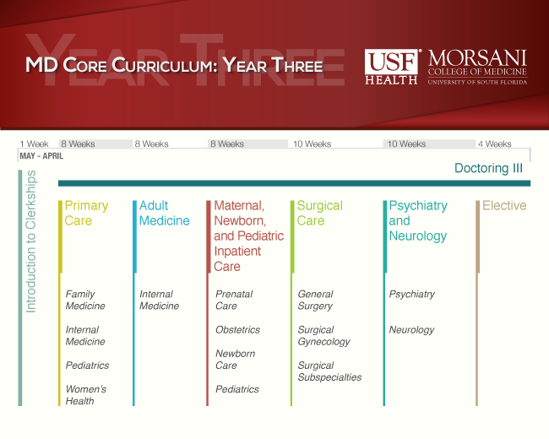
Time in the Curriculum for SCP Year 3

Slide 10
Time in the Curriculum for SCP Year 4

Slide 11
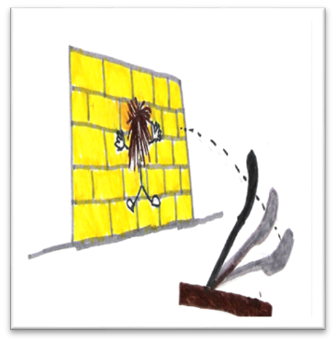
Examples of Scholarship
Publications
Presentations
But what is scholarship across all concentrations?
https://drive.google.com/file/d/0B9acvVMP0GVnM2VnY0RZN3pULWM/edit?usp=sharing

Slide 12
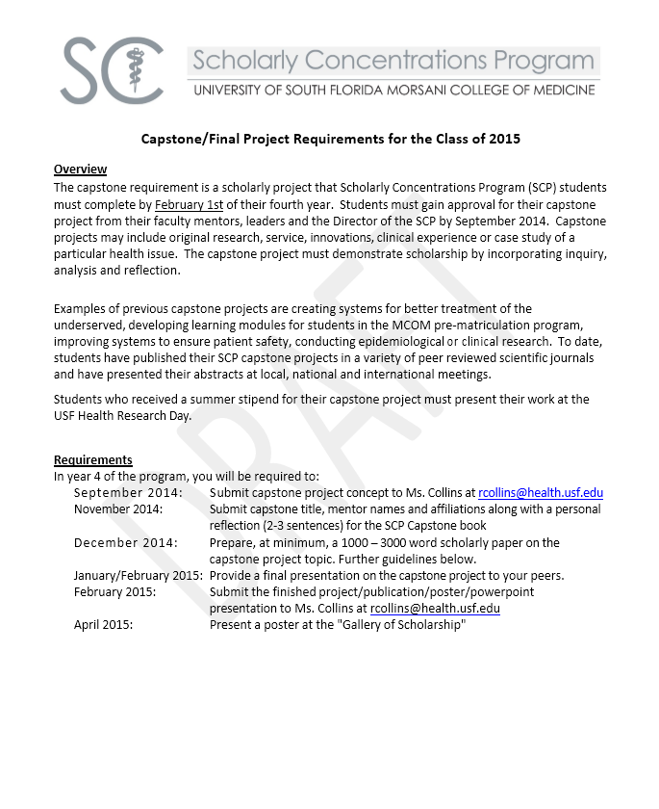
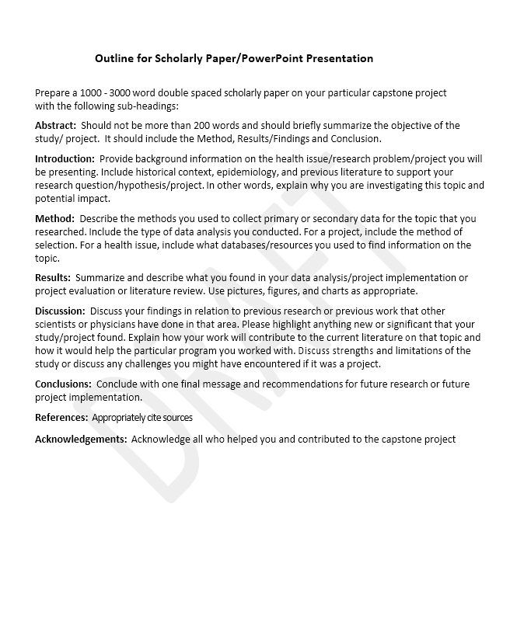

Slide 13
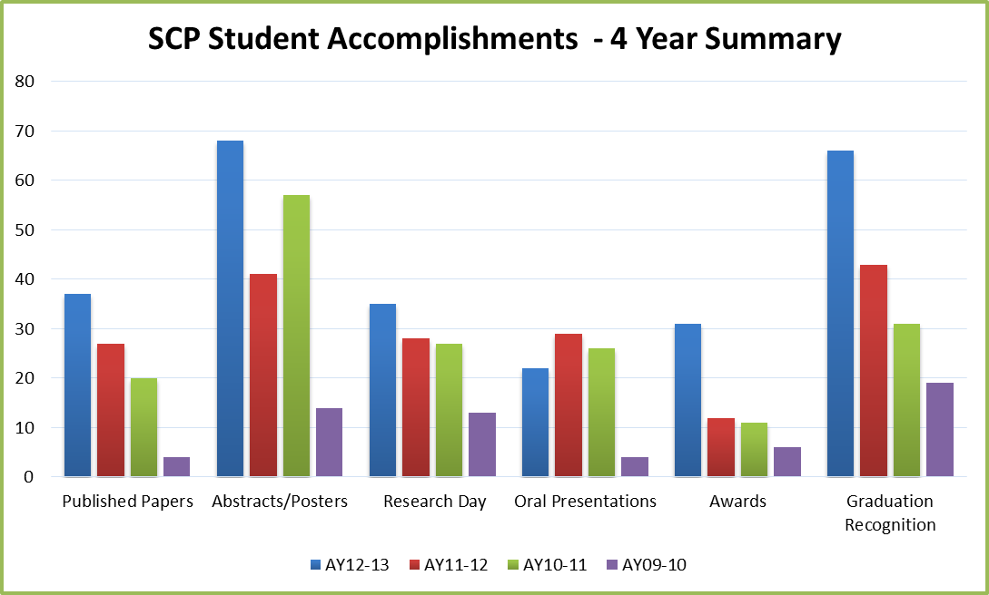
SCP Accomplishments

Slide 14
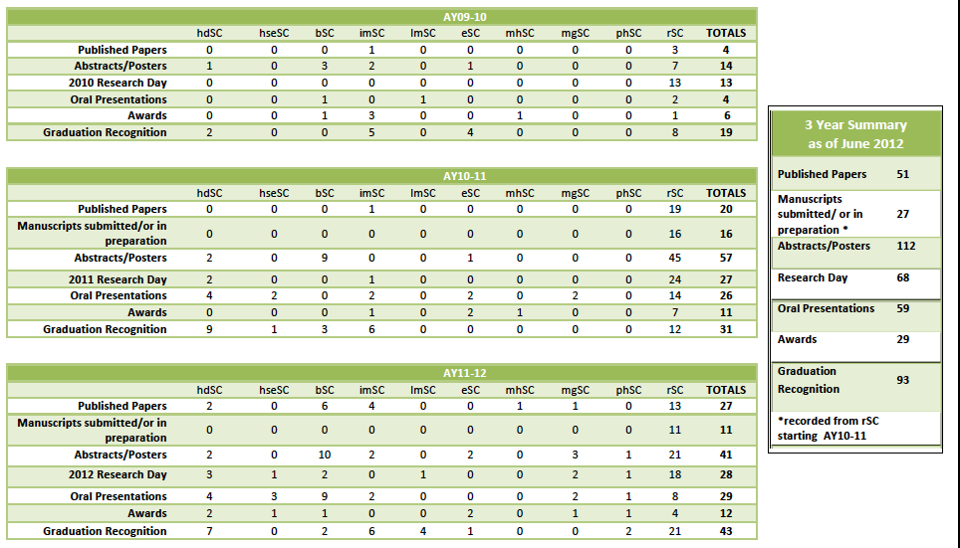
Publications

Slide 15
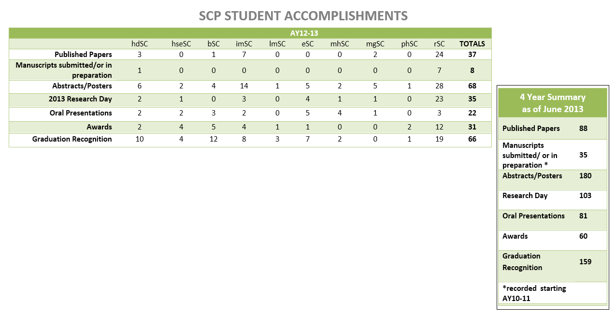
Publications

Slide 16
Examples of Capstone Projects
SC | REFLECTION | CAPSTONE NAME/MENTOR(S) NAMES AND AFFILIATIONS
Medical Education | This scholarly concentration project has given me the opportunity to truly evaluate and understand the different methodologies of teaching. From the discussions during scholarly concentration meetings to the the practical application through this project I hope to come away from this project a better educator. I look forward to building upon such a skill throughout residency. | Foster Children's Pediatric Developmental Milestones Training Mentor: Elizabeth Lawrence, MD Department of Family Medicine Morton Plant Hospital
Innovation, Entrepreneurship & Business in Medicine | Working on developing a market based model for the procurement of life saving organs helped me better understand many of the complexities associated with introducing new regulatory models into the health care system. I came away from my research with a deepened appreciation for the necessity to incorporate ethical, scientific, and business principles in any health related endeavor. | Kidney Transplantation: A Regulated, Market-Based Model to Eliminate Shortages of Organs Mentor: William G. Marshall Jr., MD, MBA Vice-Chair for Finance and Administration USF Departments of Surgery and Psychiatry
Medical Education American Heart Association 2011 Medical Student Research Fellow | This project allowed me to combine my interest in research and improving medicine with my passion for teaching. After helping develop a better way of providing radiation therapy to patients with muscle invasive bladder cancer, I was able to teach this new technique to urologists around the country through lecture and hands-on, interactive seminar, as well as educate potential candidates for this treatment in the GU oncology clinic. Educating both patients and physicians has really allowed me to experience education and teaching on both ends of the spectrum. | Intravesical Lipiodol Injection Technique for Image-guided Radiation Therapy in Bladder Cancer Mentor: Philippe E. Spiess, MD Department of Genitourinary Oncology H. Lee Moffit Cancer Center
Health Systems Engineering | The scholarly concentration in engineering allowed me to pursue my dual passions of medicine and engineering and lead to my working on a joint degree with the College of Engineering. My mentor encouraged me to follow my love of mathematics and to find a way to connect my engineering skills with my desire to help my patients. | An Automated Model for Fitting a Hemi-Ellipsoid and Calculating Eigenvalues Using Matrices Mentor: Peter J. Fabri, MD, PhD, FACS USF Department of Surgery
Biomedical Research | Having the chance to be a part of rSC has given me the opportunity to actually learn how to do research. Without much of a background prior to medical school, the rSC helped support me in getting involved. I now have 5 research projects under my belt at USF, where I have played an integral role in research methodology, IRB development, data collection, synthesis, and presentation. In fact, my first publication is expected in the coming months, something I would not have expected as a brand new student walking in on day 1. Without a doubt, rSC has helped to provide me experiences that will serve me well for many years to come. | Teaching Patient Safety Awareness in the UME Curriculum through Simulation Mentors: Kevin O'Brien, MD USF Department of Internal Medicine Dawn Schocken, PhD, MPH Director, Center for Advanced Clinical Learning and Simulation USF Department of Educational Affairs
Medical Education | During the project, Gregg Sinner and I were able to work with faculty members to put together a study of our own class and go over a large amount of data from previous years' classes regarding thoughts, opinions and suggestions for the group exam. In doing this we were able to provide the faculty with valuable information to enact changes to the curriculum, hopefully for the better. We were also able to present at an international meeting for medical educators and publish in a peer reviewed journal; both invaluable experiences. Thank you to everyone! | Group Testing in Medical Education: An Assessment of Group Dynamics, Student Acceptance, and Effect on Student Performance. Group Project with Greg Sinner, MD Mentors: Frazier T. Stevenson, MD Associate Dean for Undergraduate Affairs Office Of Educational Affairs Stanley Nazian, PhD USF Department of of Pharmacology and Physiology

Slide 17
Examples of Capstones - Continued
Public Health | The USF Health Diabetes Home for Healthy Living opened in August 2013. It's medical home design operates under the premise that patients will be more compliant when they are more comfortable in this setting. As paramount as patient satisfaction is to the center, designing a survey tool to accurately gauge it is a crucial step. | Patient Satisfaction Survey for USF Health Diabetes Home for Healthy Living Mentor: Robert M. Nelson, Jr., MD, MS Associate Vice President for Children's Health USF Health
Public Health | I learned to see the difference between research and the implementation of research. The night meetings with colleagues were more like fire side chats filled with high-level thoughts about research and medicine. | Feasibility of Supraglottic Airway Use by Combat Lifesavers on the Modern Battlefield - Group Project with Nicholas Studer, MD Mentors: Robert M. Nelson, Jr., MD, MS Associate Vice President for Children's Health USF Health John H. Armstrong, MD, FACS State Surgeon General and Secretary of Health Florida Department of Health
International Medicine | Whether I am working with a local “favela” to promote preventative health practices in Brazil or setting up a provisional clinic in the Dominican Republic to provide sustainable healthcare to its residents, this concentration has allowed me to become part of something larger than myself. My clinical endeavors and my study of HIV-associated visceral leishmaniasis have not only heightened my understanding of health hardships globally, but also have provided me with the tools to identify and implement strategies for improving health outcomes. Putting these skills into practice in residency and beyond is the next step. | Visceral Leishmaniasis and HIV Co-Infection: A Neglected Population in Brazil Mentor: Gabriel de Erausquin, MD, PhD, MSc USF Department of Neurology, Psychiatry, and Behavioral Neurosciences
International Medicine | The international medicine concentration has provided me with amazing opportunities to meet students and physicians from around the world, as well as support my abroad experience. My capstone project allowed me to reflect on what I have learned and on the actions I have taken to support global health. | An Exploration of International Health Organizations and Advocacy Mentor: Lynette J. Menezes, PhD Assistant Vice President, USF Medicine International USF Division of Infectious Disease and International Medicine
Health Disparities | I decided to join the Health Disparities Scholarly Concentration as a first year medical student because I wanted to constantly be reminded of the reasons I aspired to become a physician. It is easy to get lost in the chaos of medical school, but I am confident that I will continue to have compassion and empathy for my future patients because of the growth I experienced during my time in this program. In addition, I was fortunate to be able to complete a capstone project in the area of health care for the homeless, which is an issue that I am very passionate about. | Connecting the Homeless Population of Tampa with the Healthcare they need through the Hillsborough County Health Plan (HCHP). Group Project with Kerolos Fahmi MD Mentor: Elizabeth Warner, MD USF Department of Internal Medicine
Innovation, Entrepreneurship & Business in Medicine | Working on the BRIDGE Clinic Operations plan and Business plan helped me understand the challenges a free clinic for an otherwise under served population faces, and more importantly how to address them effectively. I learned real world applications of Business principles that not only increase the amount and quality of healthcare patient's receive but improve the patient's individual experiences at some of the most challenging times in their lives. | The Business of Medicine Bootcamp – BRIDGE Clinic Collaboration Operations Team group project with Nerissa Moore, MD Mentor: William G. Marshall Jr., MD, MBA Vice-Chair for Finance and Administration USF Departments of Surgery and Psychiatry

Slide 18
Challenges
Administration
Infrastructure
Faculty recruitment – Leaders and Mentors
How are they acquired and acknowledged?
Student evaluations
Student recognition
Short -term and long-term program evaluation
Definition of Scholarship
Program sustainability

Slide 19
MCOM Approach to Challenges
Administration - Infrastructure - One Administrator, 2 Directors
Faculty recruitment – Leaders and Mentors
How are they acquired and acknowledged? EVU System
Student evaluations - Copies available
Student recognition - Dean’s letter, Capstone book
Short -term and long-term program evaluation – A continuing challenge
Definition of Scholarship – Objective based
Program sustainability - A continuing challenge

Slide 20
Small Group Sessions
Each group has 20 minutes to discuss issues below:
Definition of scholarship
Administration
Short -term and long-term program evaluation
Faculty Recruitment – Leaders and Mentors
Student evaluation
Student recognition
Mentorship
Program sustainability

Slide 21
Ideas for the future
?

