Slide 1
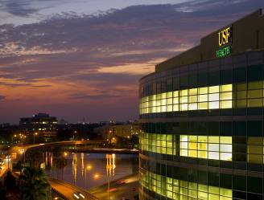
Do Scholarly Concentration Programs Contribute To Lasting Scholarship?
Ingrid Bahner PhD
Susan Pross PhD
University of South Florida
Morsani College of Medicine
Alex J. Mechaber, MD, FACP
University of Miami
Miller School of Medicine
SGEA 2014

Slide 2
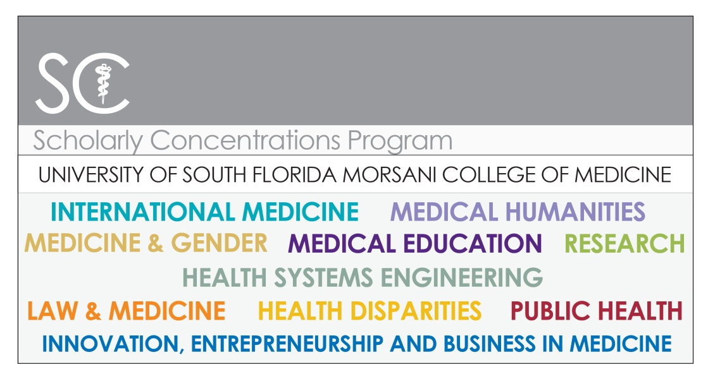
The Scholarly Concentrations Program at the USF MCOM
Health Disparities
Health Systems Engineering
International Medicine
Innovation, Entrepreneurship & Business in Medicine
Law and Medicine
Medicine and Gender
Medical Education
Medical Humanities
Public Health
Biomedical Research

Slide 3
Objectives and Goals of the SCP at USF-MCOM
The purpose of the SCP at the USF MCOM is to provide opportunities for students to participate in areas of inquiry, scholarship and creative endeavors such that they are prepared to become leaders in their fields and start on a lifetime scholarly approach to the practice of medicine.

Slide 4
Program Description
Year I
1) Students enroll in SCP
2) SCP Curriculum: IRB, Statistics, Endnote, Scholarly Writing
3) Curriculum of Individual Concentration
4) Identify Mentor for Scholarly Project
5) Write Scholarly Project Proposal
YIII
2x 2 weeks elective time to continue with scholarly project
Year II
1) SCP Curriculum: How to make and present a poster/oral, SCP symposium in the fall , USF Research Day in the spring
2) Curriculum of Individual Concentration
3) Continue working on scholarly project as time allows
Summer YI/II
Work on scholarly project
YIV
1) 2x 2 month elective time to conclude scholarly project
2) curriculum of individual concentration 3) Gallery of Scholarship at graduation

Slide 5
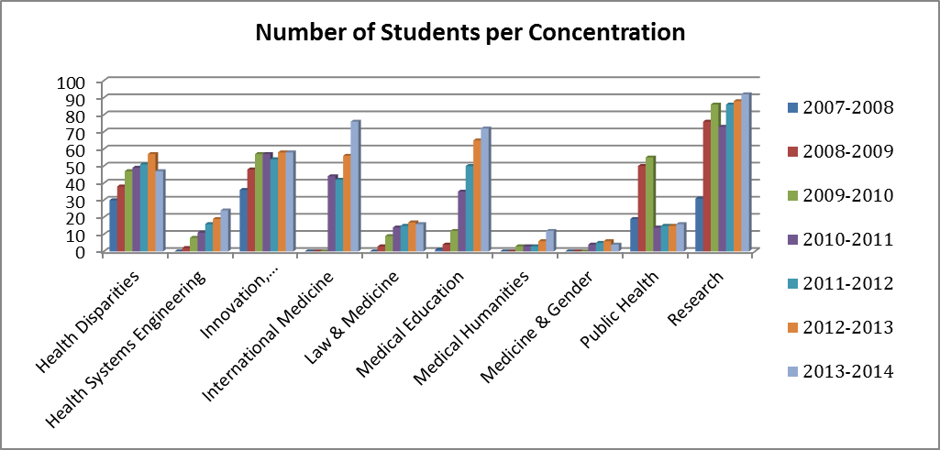
Enrollment in the elective SCP at USF MCOM 2007-2013

Slide 6
How to measure a lifetime scholarly approach to the practice of medicine?
Annual Program Evaluation?

Slide 7
How to measure a lifetime scholarly approach to the practice of medicine?
Students in the SCP classes of 2013-2015 have universally acknowledged growth as a scholar

Slide 8
How to measure a lifetime scholarly approach to the practice of medicine?
Annual Program Evaluation?
Count the number of publications?

Slide 9
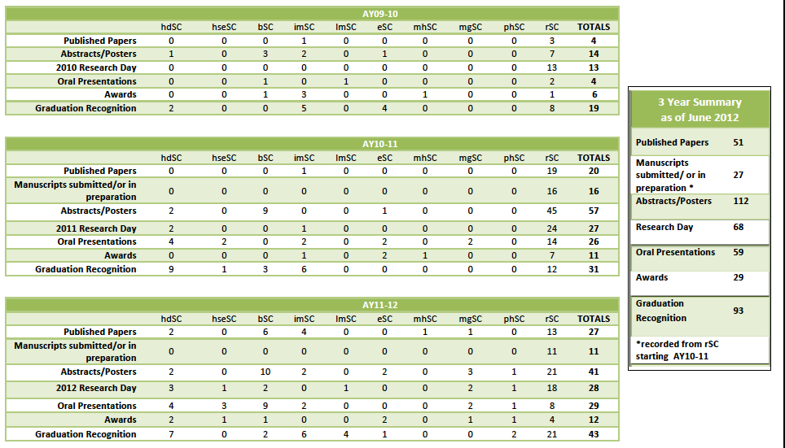
Publications

Slide 10
How to measure a lifetime scholarly approach to the practice of medicine?
Annual Program Evaluation?
Count the number of publications?
Exit Survey of the class of 2013
53% response rate

Slide 12
“Business is a hot topic in health care, there was a good number of program directors who had or were pursuing their MBA, so obviously my extensive involvement in the business scholarly concentration was a hot topic. “ bSC
Notes:
bSC

Slide 14
“Perhaps it made scholarly activities a habit that may have otherwise not been so prevalent in my extracurricular time.” hdSC

Slide 16
“It will help me become more successful because the concentration has allowed me to view better understand patients and how their adversities may effect their health. ” hdSC

Slide 18
“I have a taste for research and would like I be a mentor .“ rSC

Slide 20
How to measure a lifetime scholarly approach to the practice of medicine?
Annual Program Evaluation?
Count the number of publications?
Exit Survey of the class of 2013
Portfolio

Slide 21
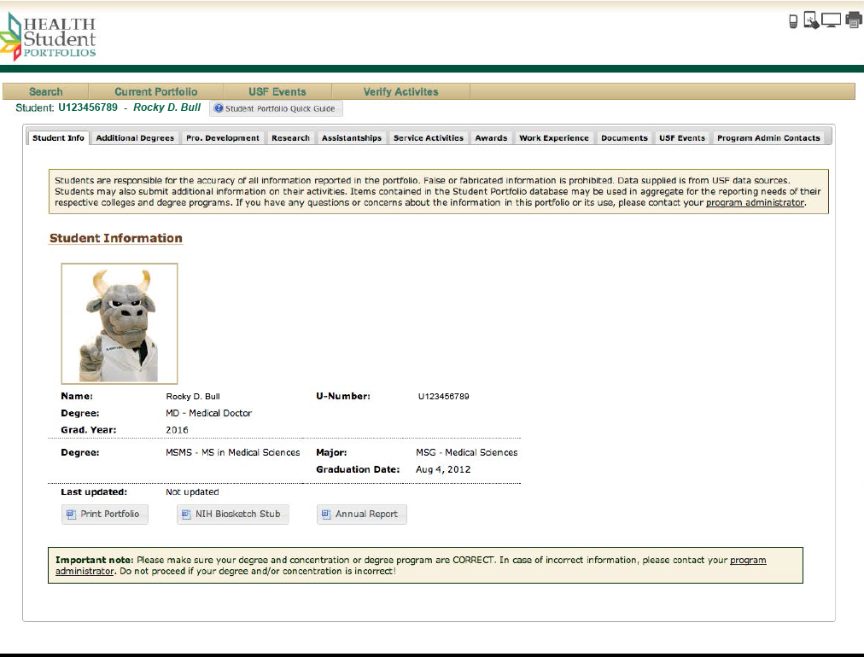
Portfolio

Slide 22
Discussion
discuss the definition of scholarship in the practice of medicine
develop methods for assessing the correlation of these programs with continued scholarship
develop guidelines for appropriate questionnaires to assess scholarship

Slide 23
Acknowledgement
The Leaders of the different Scholarly Concentration
Roberta J. Collins BS, Program Coordinator

